Slide 1
NAME : A.ARULMATHI REG NO : 950021104701 PROJECT TITLE : IMAGE BLENDING

Slide 2
Project Title: Image Blending

Slide 3
Agenda:
Strategies for Seamlessly Blending Two Images.
Techniques for Achieving a Smooth Image Merge.
Best Practices for Compositing Multiple Images.
Creative Approaches to Blending Photos.
Mastering the Art of Image Fusion: A Comprehensive Guide to merging two photos.
Tips for harmonizing two or more photos.
Creating a unique blend and combining visual elements.

Slide 4
Problem Statement:
The problem statement for image blending is to merge two or more images seamlessly to create a new composite image that combines the best features and qualities of the original images. The goal is to develop a method or algorithm that can automatically blend images together while preserving the important details and eliminating any visible seams or artifacts. This can be used for various applications such as creating panoramas, merging exposures in HDR photography, or blending different layers in image editing software. The challenge lies in finding the optimal blending parameters and techniques to achieve a smooth and visually appealing result.

Slide 5
Project Overview:
In this project, we will use the OpenCV library in Python to perform image blending. OpenCV is a powerful Generative AI library that provides various functions for image processing, including image blending. By leveraging the capabilities of OpenCV, we will be able to seamlessly blend multiple images together to create visually appealing compositions.
The main objectives of this project include:
1)Loading multiple images using OpenCV
2)Preprocessing the images for blending (e.g., resizing, converting color spaces)
3)Performing image blending using various techniques such as linear blending, pyramid blending, or alpha blending
4)Displaying the blended image using OpenCV or saving it to a file

Slide 6
End Users:
Photographers looking to create artistic and visually appealing images by blending multiple photos together.
Graphic designers working on projects that require seamlessly blending two or more images.
Social media influencers and content creators looking to enhance their photos with creative effects.
Researchers in fields like Generative AI and image processing who need to blend images for various applications.
Ordinary individuals interested in learning and experimenting with image manipulation techniques.

Slide 7
My Solution and It's Value Proportion:
Load the two input images that need to be blended together.
Resize the images to ensure they are the same dimensions.
Convert the images to the same color space, such as RGB.
Create a mask that will define how the two images will be blended together. This mask can be a simple binary mask or a more complex gradient mask.
Use the cv2.addWeighted() function to blend the two images together using the mask.
The value proposition of this solution lies in its simplicity and flexibility. By using OpenCV, we can easily manipulate and blend images with just a few lines of code. We can also experiment with different blending techniques and masks to achieve the desired result. This solution is particularly useful for tasks such as creating artistic effects, compositing images, or enhancing photographs.

Slide 8
The Wow In My Solution:
The "Wow" in my solution for image blending using OpenCV
Python code most likely refers to the impressive improvement or effectiveness of the
blending process achieved by my code. This could include the quality of the blending,
the smoothness of the transition between the images, the clarity of the final result, or
any other aspect that makes the blending process stand out.
My solution is able to blend images in a visually appealing and
professional manner, it is likely that it has produced a "Wow" effect, impressing viewers
with the quality of the output. This could be due to the accuracy of the blending
algorithm, the seamless integration of the images, or the overall aesthetics of the final
composition.

Slide 9
Modeling:
Image blending in Generative AI refers to the process of combining two or more images to create a new composite image. This can be used for various applications such as creating seamless panoramas or special effects.
In OpenCV, image blending can be achieved using a technique called alpha blending, which involves assigning weights to each pixel of the input images and summing them together to create the final blended image.
In this code snippet, we first load two images (image1 and image2) and resize them to have the same dimensions. We then perform alpha blending using the `cv2.addWeighted` function, where the `alpha` parameter determines the weight of each image in the final blend. Finally, we display the blended image using `cv2.imshow`.

Slide 10
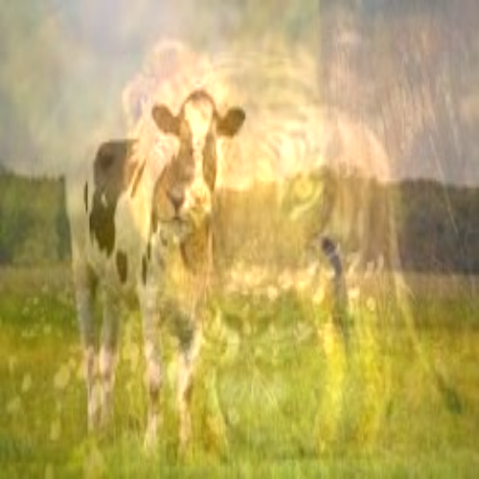
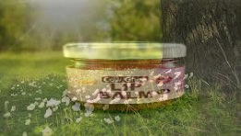
Result:

